Slide 1
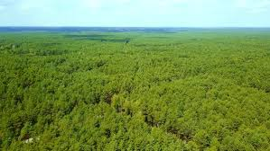
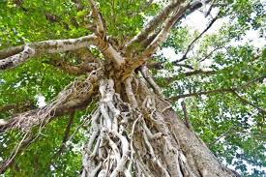
The Sociological Imagination
Notes:
The forest or the tree- Society or Individual

Slide 2
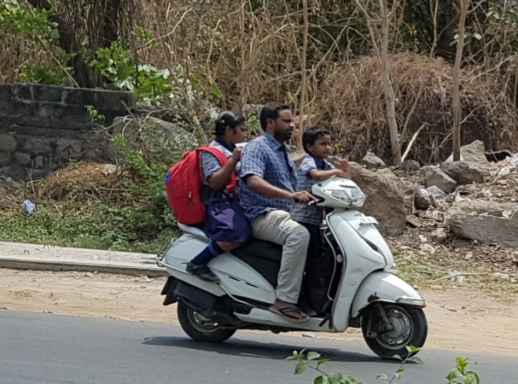
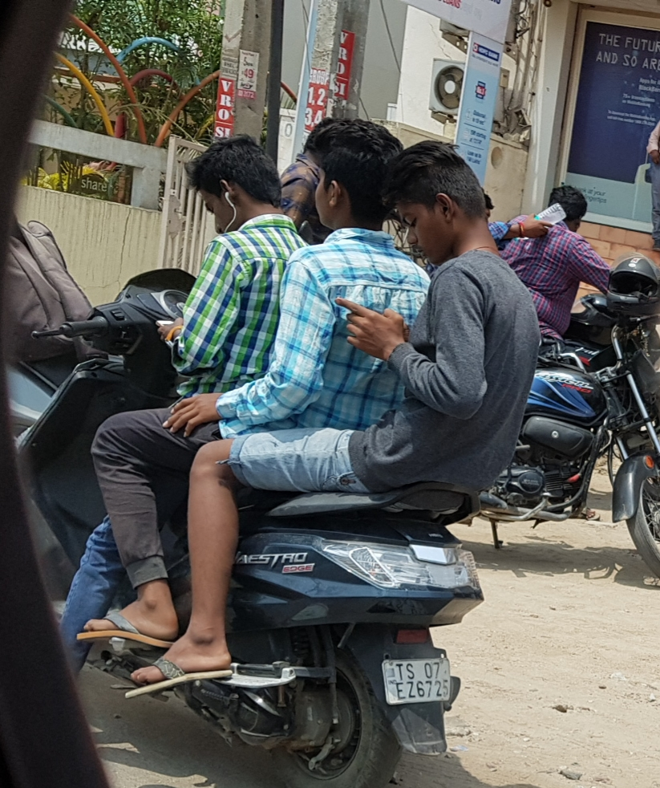
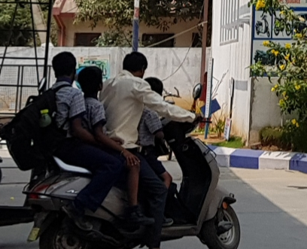
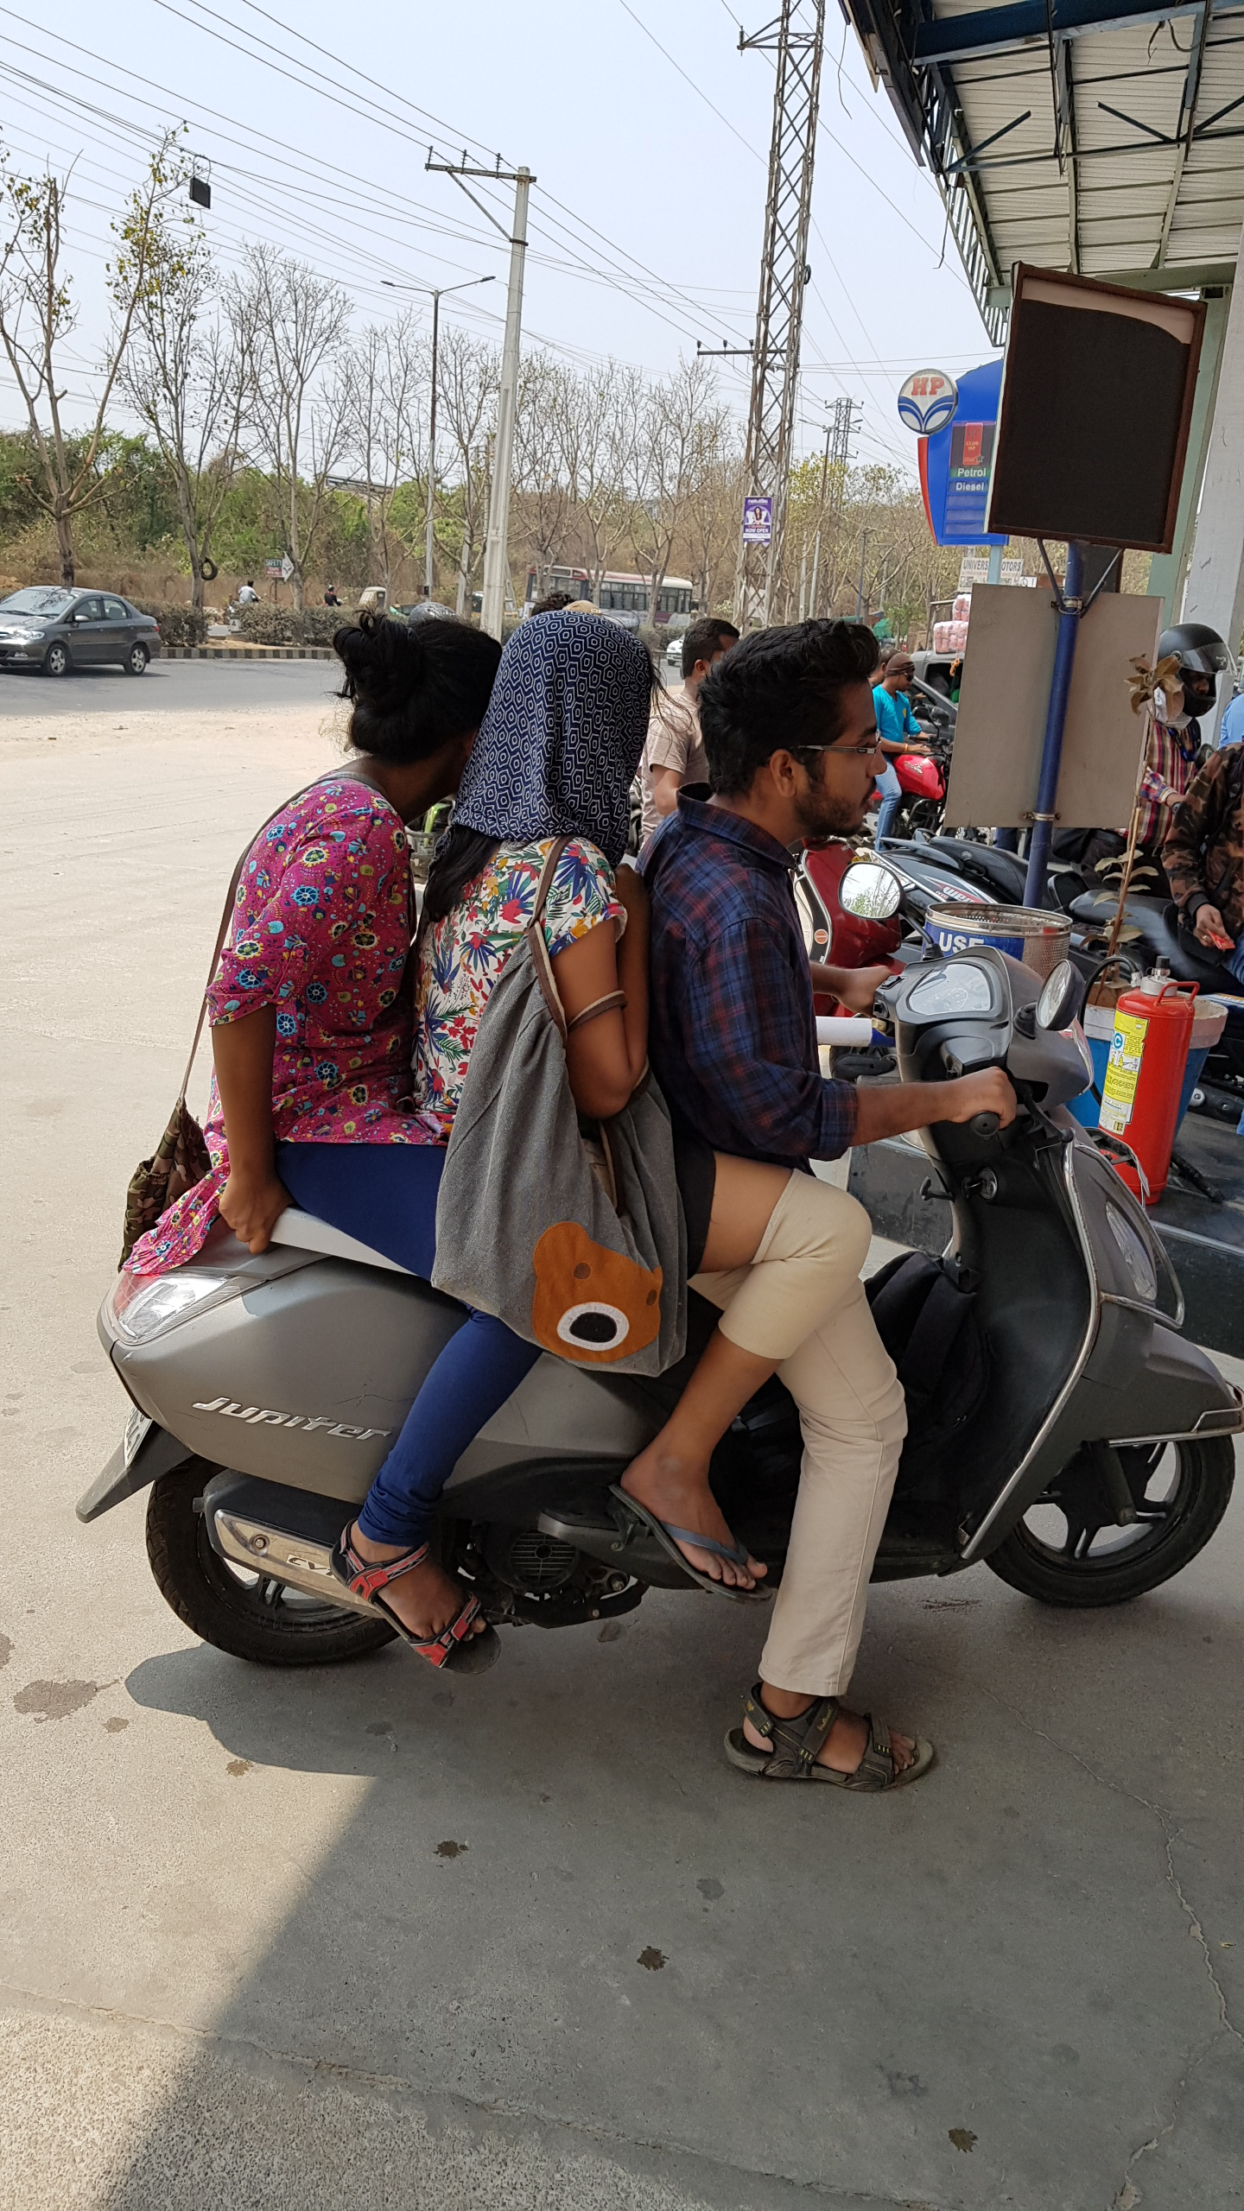
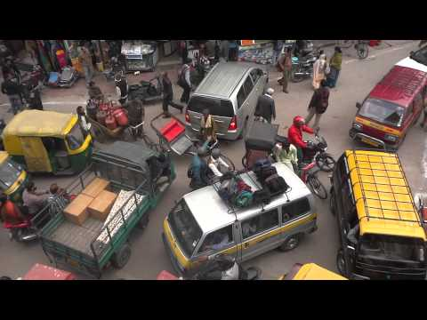
Research Courtesy Siddhartha Jain
Notes:
What is the sense of public risk here?
Idea of public safety- what about your loved ones?
Trade offs for safety- infrastructure- culture- re enforcements – penalty

Slide 3
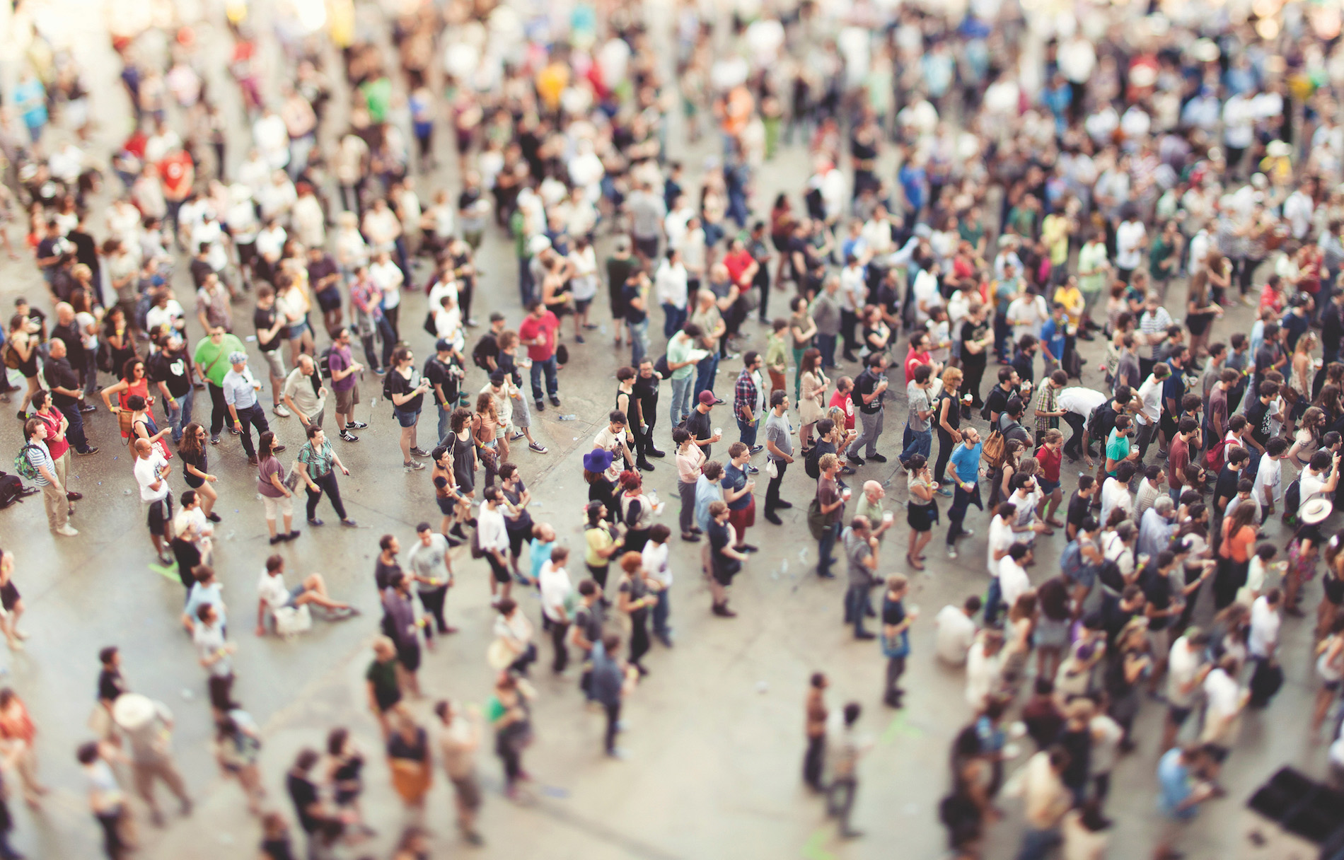
sociology as the systematic study of society and social interaction “sociology” is derived from the Latin word socius (companion) and the Greek word logos (study of)- meaning “the study of companionship” sociology is more complex and deals with a diverse range of human social behaviors and forms of society
Notes:
Social Fact- can an individual bring change overnight???
Fact is something that influences you to behave in particular ways – you behave properly with no law asking you to do so
Social laws
Does a individual have a role to play in the birth rate in a society? Can one individual change it???

Slide 4
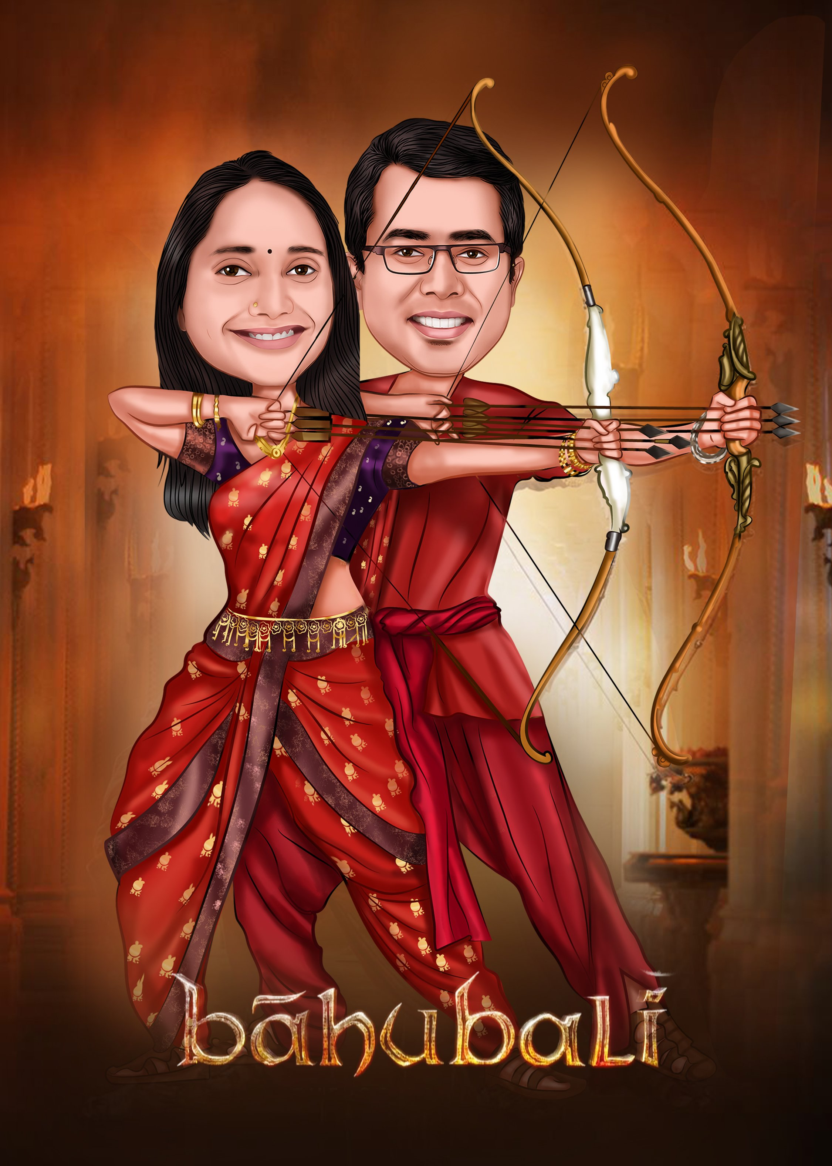
A society is a group of people whose members interact, reside in a definable area, and share a culture A culture includes the group’s shared practices, values, and beliefs

Slide 5
What is a Polite Conversation in the Indian Parliament?
What is the emerging nature of WhatsApp texting among teenagers?
How do Republicans in the USA respond to fake news on Facebook?
What are the migration patterns in Telangana?
Notes:
The context to ask a question and find answers
Structured ways to investigate questions about society and the social

Slide 6
The sociological imagination
An individual’s understanding of shared commonality with others [individuals like Her]
The sociological imagination enables us to grasp history and biography and the relations between the two within society.
(1959) C Wright Mills
Notes:
Born out of sociology Demography- Versions of history
Being together – social relations –who we are and how we got here- look beyond the individual and the sense of how they got there/here- what is going on- forces of history Class Race gender - shaping all the time
How do they intersect at the level of the individual – question

Slide 7
fruits of the sociological imagination
… is the idea that the individual can understand her own experience and gauge her own fate only by locating herself within her period…
… that she can know her own chances in life only by becoming aware of all individuals in her circumstances
Your Social Status
Your Gender
Your Family
Your Peer Group

Slide 8

Thinking about Problems – do they belong to he Individual???
Unemployment – how do you construct this WORD?
Is it a phenomenon/situation/condition?
Private troubles and public issues
Global forces at play
Why is one privileged over another
Plumber or a Day Care Teacher or Fighter Pilot
Differential Wages! Gender or Society or History
Notes:
Similarly situated to me …
I have to link up with people who have the same predicament- caused by the same forces of history
Series of things that are interlinked
Intersections – biology and history
Oriented towards individual problems – repertories of problem – unemp; health care; deprivation- what went wrong? Cant get a job? Its me or the social or society
What's with the economy? Political and global forces- how is it that economy values one kind of job
Women doctors receive lower income – is it doctoring or the surrounding history of that society
Why am I?
Answer- Political and moral
Unemployment – it’s a bout the structure of the situation and how they evolved over history
Mens and womens unemplpoyment

Slide 9

Personal predicaments as social
Find individuals like you
Find situations like yours

Slide 10
Its about everybody…
Notes:
Following the soico imag- engaged only sociologists have???? Its about citizenship everyone –
A call for a better world… engaged in the world-
Knowledge of this world is not intuitive- systematic observation and engagement – a kind of knowledge- what citizenship should be

Slide 11
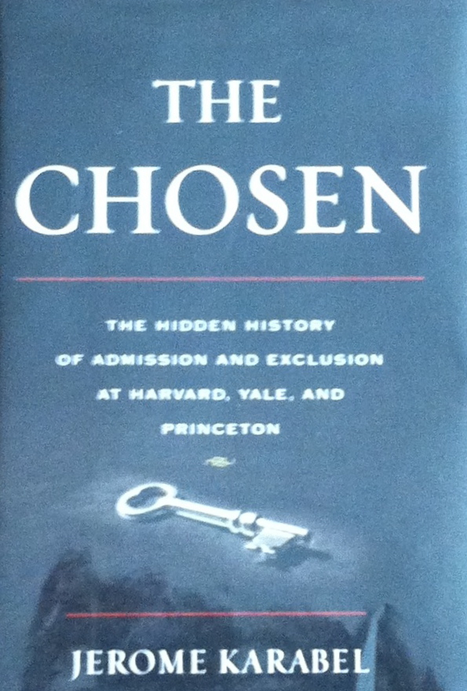
Take education…
Entrance tests were by birth and the mode of family
Jews and the Ivy league in 1930s
Harvard wouldn't’t be Harvard any more if Harvard is more than Harvard
Notes:
Malcolm Gladwell –
The Chosen – Jerome Karabel -How people actually get in to schools that many did not
Why are you here is why are you not there…
Harvard is many things not just ivy league
Letters of reference – extra curricular- keeps the Jews out…? Mechanism other than merit can count – to a degree that is unaccountable- how do you decide someone had character? Subjective mechanisms to change the outcome
The alum network – forces at work that get you there – Legacy + Athletes –
Academic admit – purposefully need to be forged in Princeton- meritocracy of Ivy league
Who should get in and how to decide – what and who succeeds
What kinds of success students have? Back fill like ones who succeed- don’t have to know why? Predictive- then what success mean?
What success means is in itself another variable- structures what is going to be the results and how its all going to work

Slide 12
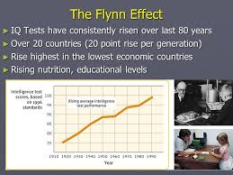
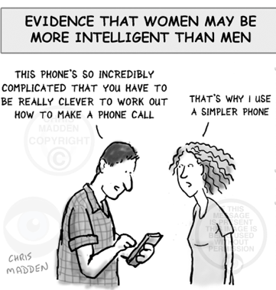
What makes someone Smart?
Higher education – Admit smart people!
The IQ test?
Raw smartness???
Flynn Effect
Notes:
IQ scores – across history – 100 ears in US and Europe – they keep going up – average to Moron
Much smarter today ---- is it intrinsic intelligence? Genetic?
Judy Handel- school children – 3-4 grade – Triangle – piece of paper puzzle … how did one child know? Hidden curriculum of the middle class home- social context of Miss Jones – Mr Smith has a different imagination…
Reading the context – right answer right place right time etc… comes from other aspects of life- impacts entering a school

Slide 13
Can Sociologist explain outcomes/ even partially across social settings and historical times
More prestigious the University higher the income of families who send their children
… and this tends to hold across time…
Notes:
Appropriate child in Appropriate education
Mobilizes the world on your behalf is unequally organized – Micro Macro- processes
Bold processes of discrimination institutionalized- get naturalized way of getting into school with smartness
Have consequences… they are human made and changed- result of history and politics
Public Univ in Cali– average income of families [ UC] are double than in the state colleges – community colleges even lower - clear class hierarchy- Subsidy system – Finding – as subsidy to transfer privileges - critical and not so critical- working class families benefitting

Slide 14
Ideas around Society and how they Function…
Is society like a CLOCK or an ENGINE …
Each INDIVIDUAL UNIT has a role to play in a SYSTEM
MANIFEST and LATENT functions of a system
Notes:
Society a stable arrangement of parts that moved together – society works like a clock? Does it??
Everyone contributes and each has a role to play
Social bonds keep people and parts of society together

Slide 15
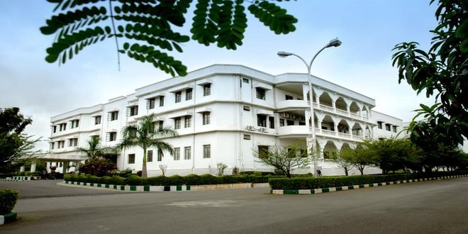
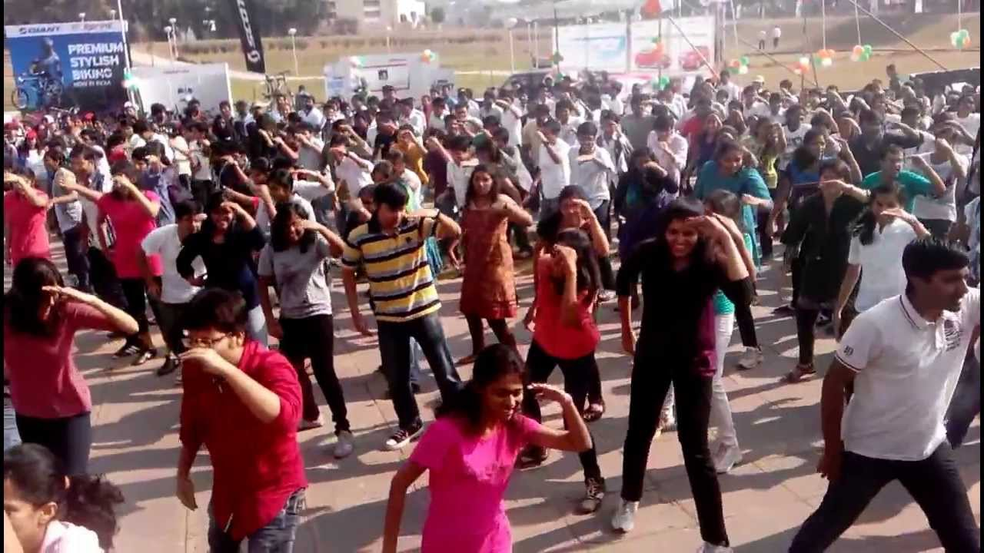
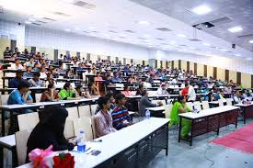

Slide 16
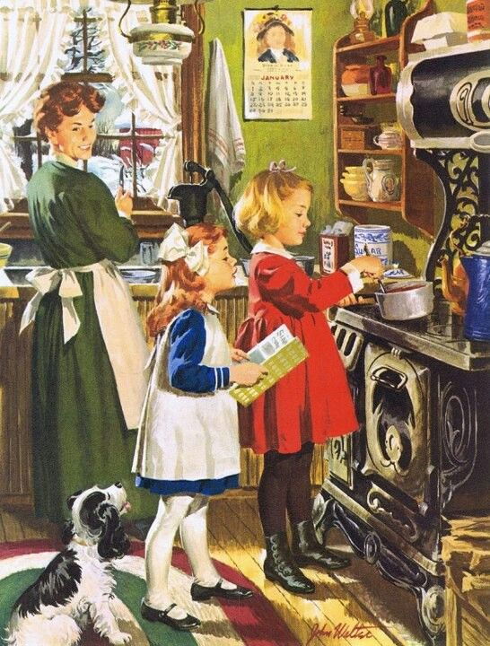

SO… when and how can a society change…
What about Gender Equality?

Slide 17
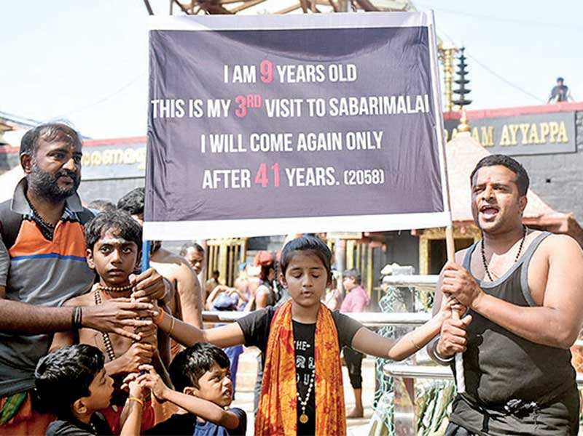
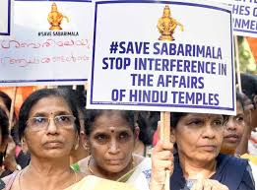
Emile Durkheim
What can we learn by looking at human social Data
Suicide and Capitalist Societies
Capitalism the Protestant Religion
Religion and Politics
Politics and Gender

Slide 18
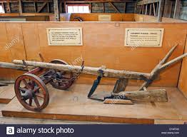
Ask what tools a society produces and for What…
Notes:
Materialistic understanding of history

Slide 19
Conflict Theory to understand Society and Social evolution
The conflict for resources

Slide 20
Listen… what about Social Status
Notes:
Max Weber and Caste Class Status
When income and status don’t intersect
Gender and Status ?

Slide 21
What are today’s Conflicts…

Slide 22
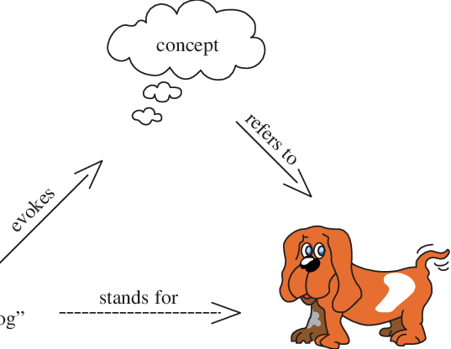
Society Played out through everyday interactions
Language
Meaning
Symbols & Signs
Do
Notes:
Thinking things – think about ourselves-
Subject –Object at once
Do it through Symbols – Words > Consciousness with words – a things like the word and stands for the object – through these symbols the capacity to interpret – see a sign and process that too –
For the animal or the birds these are Innate fixed action patterns – Instincts that guide behavior

Slide 23
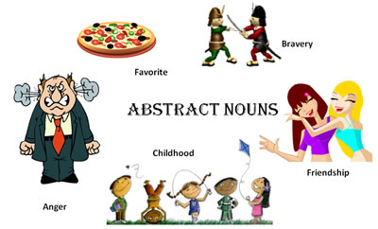
Meaning making through symbolic interaction
Childhood
Music
Tattoos
Cars
Foods
Weddings

Slide 24
The importance of Non- instinct

Slide 25

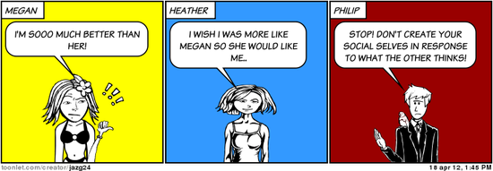
The Looking glass self and what drives people…
Notes:
G H Mead –Sym Int – what I am and what I do – what she will see – wave rather than hit- formed through the self I am creating – I that acts- Me the object form of self – anticipated viewpoint of other human beings – Sense of self is formed through the evaluation of others – you are a collection of a history of moments of morality etc.- accretions built up over our biographies
What is true self? – how the world works – to fill the empty box of self- through interactions with others – Social Self – laying stuff on us- it is us!
Only way we can have a self –

Slide 26
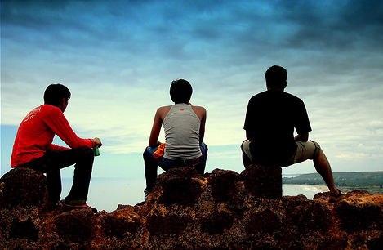
Who are your reference groups?
Notes:
Du Bois – who are the reference group - for racial minorities –double consciousness – Black people think in a framework that involved the lens of white people- no true self consciousness- looking at oneself through the eyes of the others- there is multiple consciousness for an average self – but they are all a part of a community- not the other- immediate family; friends; also White people as a lens! The overload…

Slide 27
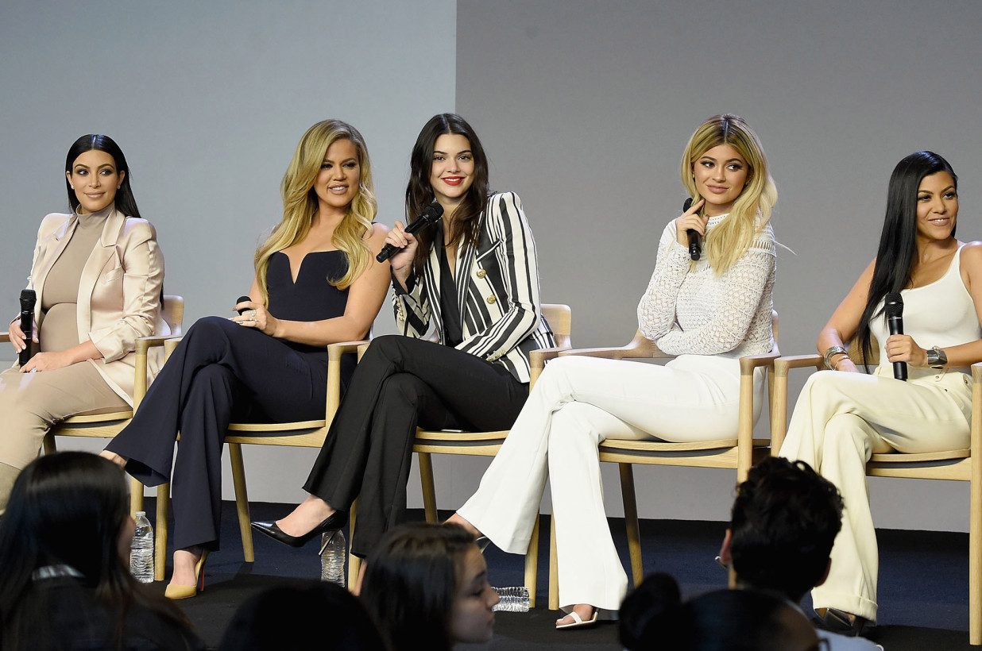
Giving off information
We think the most about ourselves… who influences it?
Humans in constant interaction – a very complex one with society
Always aware of evaluation by others- making ourselves up for this evaluation
Notes:
Self is always evolving – Dynamic of the social self [ radical! Sometimes]
Social Order- anticipating what other will think – no crazy nutty – basis of social solidarity is the need to get along

Slide 28

Significant others & Conformity
Who are the significant others in your life?
Is it the same for all groups and communities e.g.: the Whites and Blacks in the US
Notes:
Some people more significant than others – more control over your sense of self
Who counts- some. Irrelevant others. Generalized others. Reference group.

Slide 29
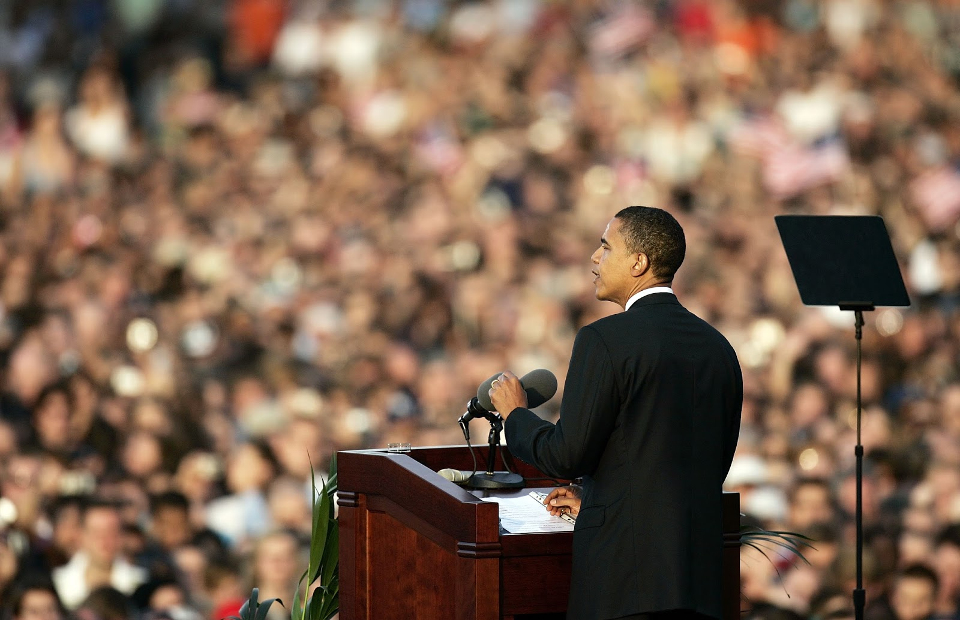
Micro interactions in the everyday
System of interactions – individuals seek their self fortunes through interactions
The search for a positive sense of self
Observing social behaviors … Studying this acting…
The capacity to generate audience performance
Self reinforcement – in collective ways
How politicians generates applause
Ways you get people to clap – trap!
The graph of the clap
Social cues about when to clap
Notes:
Max Atkinson Clap trap
Micro interactions – performance in orderly and appropriate way – accumulating positive evaluation of others
Back stage language of the theatre – where we prepare
Winning audiences – for ourselves
What is our backstage ? Bathroom! Changing clothes!
Being seen as competent – capacity to be part of the environment
No time out-
Managing eyes carefully – appropriateness
Staring! OK in India …. Take the role of the other- what would I look like if I was that role
Holding a glance and managing it…

Slide 30
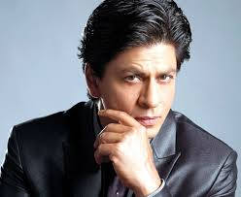
A Positive sense of self…
Notes:
Mechanism Wind Up. To see a positive sense of self- The drive. Freud – Bio Deep – what is this drive? Money Religion Martyrdom Leader
But each is different- how to save the individual? Each path towards the evolving sense of self is dynamic- no one is pulling the strings – but the shaping is mutual and interactional
Charisma in a situation and not in an individual
Capacity to provide cues – to respond favorably
SRK…
Alter and manipulate a social situation

Slide 31
Gendered micro interactions
How does social hierarchy happen in the everyday
The socially weak have less capacity to shape social practices
Notes:
To participate in the social world … capacity to shape it
Linguists and conversation analysts
Rules vs practices

Slide 32
An Empirical Study of Social Taste how are choices made
Children's First Names: An Empirical Study of Social Taste
Stanley Lieberson and Eleanor O. Bell
American Journal of Sociology
Vol. 98, No. 3 (Nov., 1992), pp. 511-554
Notes:
Children's First Names: Sports Diet Finance Politics – exogenous and endogenous
Making choices unaware of participating in collective movement but with internal impulses
First names…. Accessible public data- know about class race leadership bias inequality conservatism change -
Exogenous – from the outside – how people choses first names- a restricted list in France
Diversity – Govt religion Culture restrict first names or opens up
Gendered names – one set of jobs not overlapping with gender – occupational segregation gender and race
Stigma Asymmetry – a boy named Sue… Sam? How stigma masculinity femininity works in society More critical for males to be distinguished from males… penalty paid by feminine men
Endogenous – Hillary not anymore – names rise and fall together – this arc patterns clues us in to the social /aspects probably work across the board …. An internal dynamic and logic-
1920s Jewish names – born in the US from vast immigrations – Anglo names Morton Stanley Harvey Melvin Marvin [ English] assimilating into the US – not consciously assimilating- as a group conforming and assimilating successfully- naming behavior – WASPs begin to see these very names as Jewish names – Lance Julian [ old Jewish names] Name looses its assimilation value – the next gen of Jewish names drop these – African American assimilating Marvin Gaye – other kinds of ethnicities at work – telling us the way ethnicity is operating – the civil movement – MLK - take on African sounding names – isha sounding
Lynn sounds in the mainstream – signaling a difference and self awareness – not just assimilation but collective distinctive orientation – is the mother aware that this is part of the larger collective movement ? Has consequences in spheres…
Hispanics- middle space – variations of Mexicans and WASPy – Asian Americans – more WASP American names –
Rapid assimilation of Asians in the occupational structure of American life – Residence Marriage
The logics of conformity and distinction
Unusual names – Eleanor Cordelia – rise and fell – maybe parents were part of that – pioneers- bringing back an old name – hoping that –old stories are re-told- not the only Lance/Eleanor/Sam –
Pioneers- not pioneers – acceptable names now- daring moved to not so much
Tragedy of the last Edith – quirk of an individual choice endogenous
Last Edith – uncool! Change form conformity and distinctive and back – stigma sometimes-

Slide 33
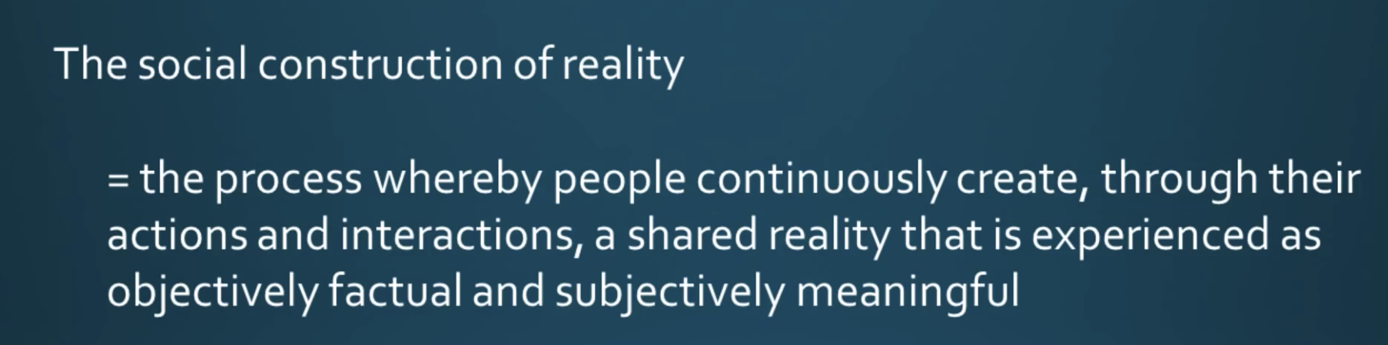
Social Construction of Reality What is Real … constructed by humans
Many things exist because we created them

Slide 34
Research Courtesy Siddhartha Jain
Notes:
What is the sense of public risk here?
Idea of public safety- what about your loved ones?
Trade offs for safety- infrastructure- culture- re enforcements – penalty

Slide 35

things that are socially constructed
Money
Electricity
Writing
Nation

Slide 36
The idea of who we are……………….

Slide 37
